Slide 1



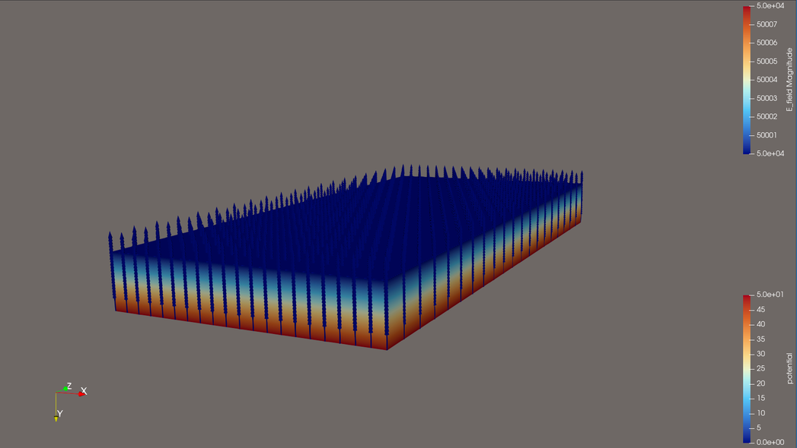
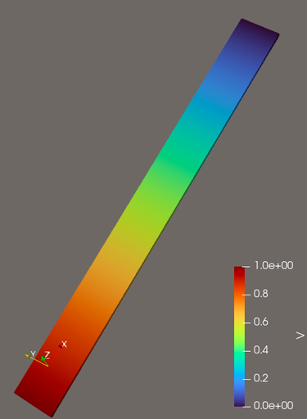
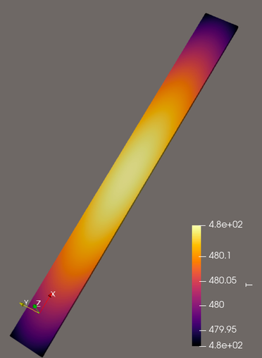
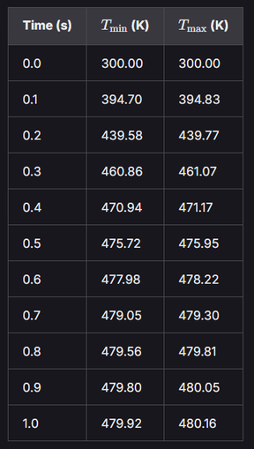

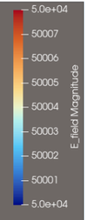

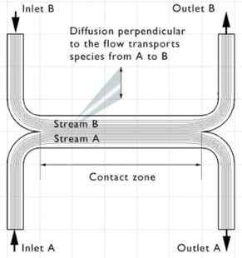
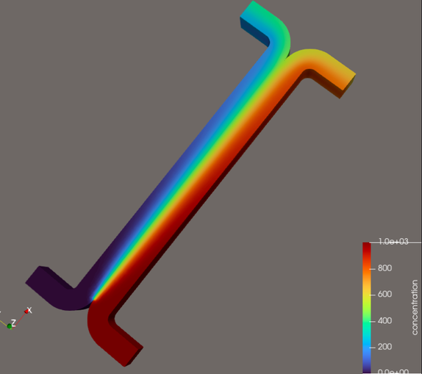
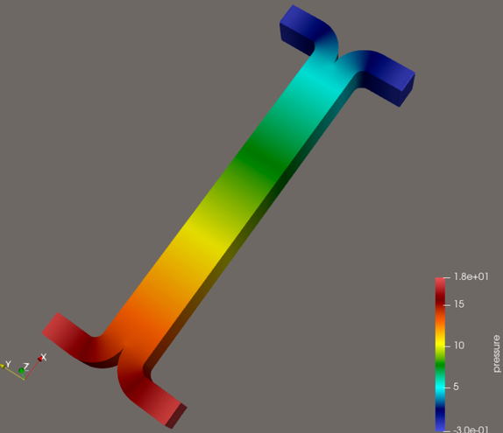
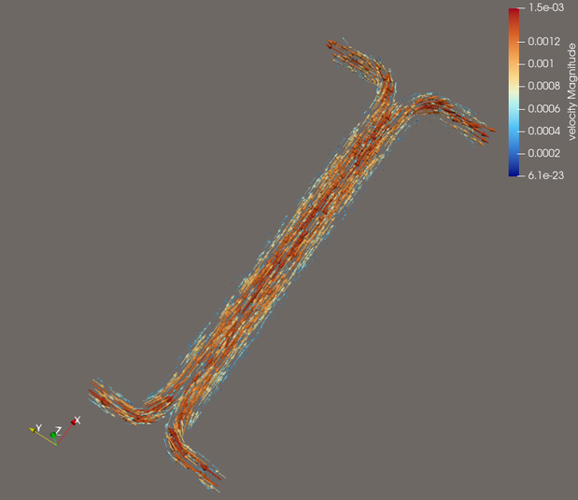
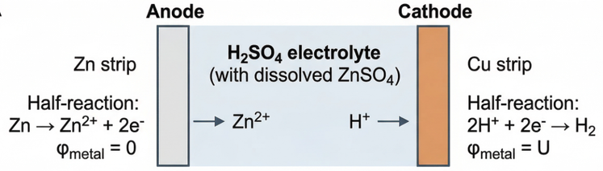
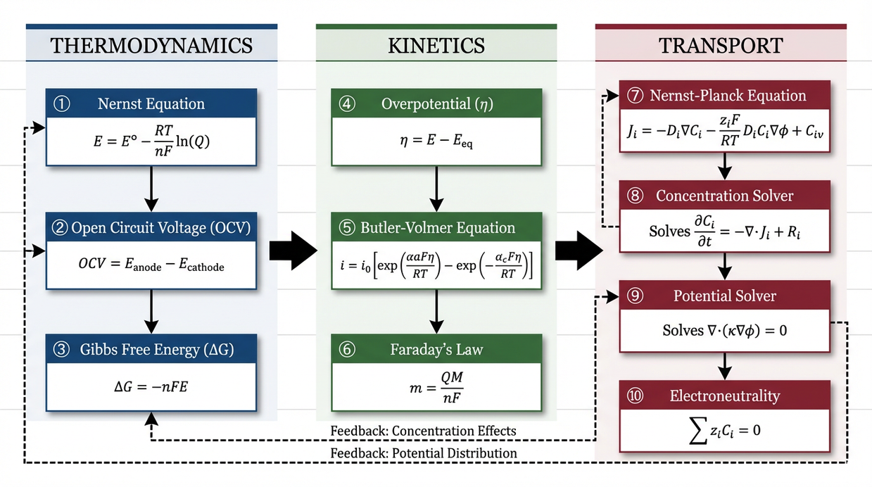
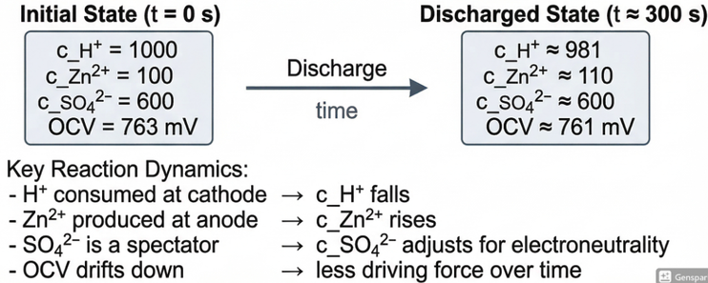
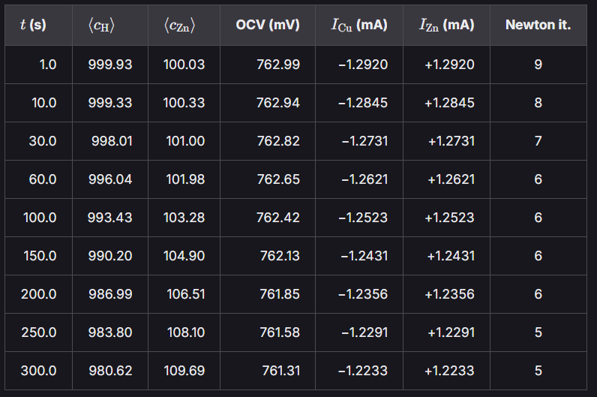
Numerical Modeling of Multiphysics Electrochemical Systems and Flow Batteries
Divya Gupta | ED22B047
Industry Mentor: Mr. Utkarsh Tripathi
INTRODUCTION
PROBLEM STATEMENT
Partial Differential Equations (PDEs) are used to model transport phenomena such as fluid flow, heat transfer, & electrostatics in electrochemical systems.
Numerical methods Finite Difference Method (FDM) & Finite Element Method (FEM) discretize PDEs to simulate system: prediction, analysis, model refinement.
Flow batteries store energy in liquid electrolytes that circulate through an electrochemical cell to generate electric current by redox reactions.
Develop and validate a multiphysics computational framework in FEniCSx to simulate electrochemical systems, integrating species transport (Nernst-Planck), reaction kinetics (Butler-Volmer), and transient behavior for flow battery applications.
Additionally, benchmark FEniCSx across diverse real-life phenomena problems (electrostatics, heat transfer, and fluid flow) to assess its accuracy, stability, and versatility as a general-purpose PDE solver.
Compare FEM vs FDM for multiphysics electrochemical problems (stability, cost, etc).
PROBLEMS SOLVED & MULTIPHYSICS SIMULATIONS
OBJECTIVE: Assess the capability of FEniCSx as a platform for implementing Finite Element Method (FEM) simulations
PROBLEM I: Electrostatic potential & field in a capacitor
PROBLEM II: Joule’s Law of Heating in a Conductive Block
OBSERVATIONS & RESULTS:
Governing Equations | ∇²φ = 0 in Ω (for a region with no free charge) E = −∇ϕ
Boundary Conditions | Dirichlet: ϕ = 0 on bottom plate ϕ = 50 on top plate Neumann: ∂ϕ/∂n = 0 on side walls (insulating)
Weak Form | ∫Ω ∇v · ∇φ dΩ = 0
OBSERVATIONS & RESULTS:
Governing Equations | Potential: −∇ · (σ ∇V) = 0; E = -∇V; J= σE Heat Transfer: ρCₚ (∂T/∂t) − ∇ · (k ∇T) = σ |∇V|²
Boundary Conditions | Electric BC: Dirichlet: V= 1 on x=0, V=0 on x=L Neumann: ∂V/∂n = 0 on side walls (insulating) Thermal BC: −k ∂T/∂n = h (T − Tₐₘᵦ)= −k ∇T · n = 5 (300 − T) Initial Condition: T(x, t=0) = 300K
Weak Form | Potential: ∫Ω σ∇v · ∇V dΩ = 0 Thermal: (ρCₚ/Δt) ∫Ω T v dΩ + ∫Ω k ∇T · ∇v dΩ + h ∫∂Ω T v dS = (ρCₚ/Δt) ∫Ω Tⁿ v dΩ + ∫Ω σ |∇V|² v dΩ + h Tₐₘᵦ ∫∂Ω v dS (Transient, Backward Euler)
The electric potential varies linearly between the parallel plates for uniform dielectric (ϕ is 0V and 50V at bottom (y=0) & top plate (y= Ly) respectively)
The electric field is uniform throughout the dielectric. The negative sign indicates the field point from high potential to low potential
Linear variation of potential from 1 V to 0 V across the domain gives uniform field & current density
Non-linear Temperature rise (Joule heating σ|∇V|²), peaks inside the domain & smooth decay towards boundaries due to convective cooling
(where ϕ= potential, E= field, v= trial function, n = normal vector)
(where V = potential, T = temperature, E = electric field, J = current density, σ = electrical conductivity, k = thermal conductivity, ρCₚ = volumetric heat capacity, h = convective coefficient)
OBJECTIVE: Simulate steady-state fluid flow in an H-Cell Microchannel device
PROBLEM SETUP:
NUMERICAL IMPLEMENTATION:
OBSERVATIONS & RESULTS:
NUMBERS CALCULATED:
Initially:
Stream A: c=1
Stream B: c=0
Finally:
Stream A: c=0.5
Stream B: c=0.5
Used mixed FEM (Taylor-Hood P2-P1) for stable veocity-pressure (u-p) coupling for Stokes flow
Species transport: Galerkin FEM & SUPG (Pe ≫ 1) for convection-dominated regime
Stokes (u, p) solved first then concentration (c) with convection-diffusion equation
Reynolds number: Re = ρuH/μ ≈ 0.015
Péclet number: Pe = u·BW/D ≈ 200
Damköhler number: Da = (D·BL)/ (u·W·BW) ≈ 0.075
Governing Equations | Boundary Conditions | Weak Form
Stokes Flow (Re ≪ 1): −μ ∇²u + ∇p = 0 ∇·u = 0 Species Transport (Steady): u · ∇c − D ∇²c = 0 (Convection-Diffusion) | Flow: Walls: u = 0 (no-slip) Inlets: Parabolic velocity profile & Outlets: p = 0 Species: Inlet A: c = 1, Inlet B: c = 0 Walls & outlets: ∇c · n = 0 | Stokes (P2–P1): μ ∫ (∇u : ∇v) dx − ∫ p (∇·v) dx − ∫ q (∇·u) dx = 0 Convection–Diffusion (with SUPG): ∫ (u · ∇c) v dx + ∫ D (∇c · ∇v) dx + ∫ τ (u · ∇c)(u · ∇v) dx = 0
Flow remains laminar and fully developed (Re ≪ 1)
Transport is convection-dominated as Pe >>1 (needs SUPG)
Limited species exchange due to low Da (weak diffusion)
Efficiency (η) strongly depends on diffusivity (D) and velocity field (u), which governs concentration gradients
KEY TRENDS (η):
η = (solute flux at outlet B) / (solute flux at inlet A)
η ∝ (D × BL) / (u × W × BW)
max η = 50% (equilibrium stage)
(where c = concentration, u = velocity, p = pressure, D = diffusivity, ρ = fluid density, μ = dynamic viscosity, H = channel height, W = channel width, BW = bridge width, BL = bridge length, n = outward normal vector)
OBJECTIVE: Simulate a transient species transport in Galvanic Cell
PROBLEM SETUP:
ASSUMPTIONS:
PROBLEM FLOWCHART:
NUMERICAL IMPLEMENTATION:
• No explicit double layer modeling at electrode-electrolyte interface
• No H₂ gas evolution (bubble formation)
• No convection (stagnant electrolyte; transport via diffusion & electromigration only)
• No side/corrosion reactions considered
• Exchange current density: j₀ = 1 A/m² (Cu & Zn)
• Initial Zn²⁺ present (c_Zn = 100 mol/m³ to represent instantaneous dissolved ZnSO₄)
• Implicit time integration (Backward Euler) for transient species transport
• Nonlinear electric potential solved using the Newton’s method (custom Newton solver)
• Butler-Volmer kinetics applied as nonlinear Robin boundary conditions
• SUPG stabilization applied for advection-diffusion (Nernst-Planck) equations
• Linear systems solved using LU factorization
• Operator splitting: φ solved first, then species transport updated, reaction kinetics applied, and time step advanced
Governing Equations | Boundary Conditions | Weak Form
Electric Potential: ∇ · i = 0 (charge conservation) i = −κ ∇φ − F Σ zᵢ Dᵢ ∇cᵢ (ionic current) κ = (F²/RT) Σ zᵢ² Dᵢ cᵢ (ionic conductivity) Species Transport (for each species i): ∂cᵢ/∂t + ∇ · Nᵢ = 0 Nᵢ = −Dᵢ ∇cᵢ − (zᵢ Dᵢ / Vₜ) cᵢ ∇φ Discharge Voltage U= 0.5V (OCV= 0.763V) | Electric BCs: • i · n = j_Cu at cathode • i · n = j_Zn at anode • i · n = 0 on walls (insulated) Species BCs: H⁺: N_H · n = −j_Cu / F at cathode and 0 elsewhere Zn²⁺: N_Zn · n = −j_Zn / (2F) at anode and 0 elsewhere Electroneutrality (constraint): c_SO4 = (c_H + 2 c_Zn) / 2 | Electric Problem: ∫Ω (κ∇ϕ + F∑ᵢ zᵢDᵢ∇cᵢ) · ∇v dx − ∫ j_Cu v dS − ∫ j_Zn v dS = 0 Species Transport (Implicit Euler): Bilinear form: a = ∫Ω (c_t/Δt) w dx + ∫Ω Dᵢ ∇c_t · ∇w dx + ∫Ω (bᵢ c_t) · ∇w dx Linear form: L = ∫Ω (c_n/Δt) w dx − ∫ N_electrode w dS
OBSERVATIONS & RESULTS:
H⁺ decreases and Zn²⁺ increases over time, reflecting consumption at cathode & production at anode
OCV gradually drops due to concentration-dependent Nernst shift, reduced driving force during discharge
Current decreases with time as the electrochemical driving force reduces & I_Cu + I_Zn = 0 (current is conserved)
Transport dominated by electromigration near electrodes and diffusion in bulk
Ion transport shows strong coupling between concentration, potential, and reaction kinetics
Concentration gradients are strongest near electrodes, where reactions occur, while the bulk remains relatively uniform
(where c = concentration, i = ionic current density, φ = electrolyte potential, D = diffusion coefficient, z = ionic charge number, F = Faraday constant, R = universal gas constant, T = temperature, j = electrode current density, N = species flux, E⁰ = standard reduction potential, E_Nernst = equilibrium potential, OCV = open-circuit voltage, η = overpotential, α = charge transfer coefficient, V_T = thermal voltage)
LEARNINGS
FUTURE SCOPE
Learned how real-life physical systems can be modeled using PDEs, choose appropriate boundary conditions, validate outcome with analytical/ physical trends.
Implemented transient simulations using Backward Euler, learned Newton Method for solving non-linear PDEs, understanding multi-physics coupling for various phenomena in a given problem and ensuring numerical stability & convergence.
Develop a complete flow battery simulation model including electrolyte flow, species transport, electric potential, and electrochemical reactions.
Flow battery optimization: varying geometry, flow rate, grid storage, etc.
Use the model for design optimization & performance prediction of energy storage electrochemical systems.

